Slide 1
SideKick
Brandon Mckinley
COMPSCI 2
May 12, 2025

Slide 2
Who the heck am I and what the heck is Sidekick?!??

Slide 3
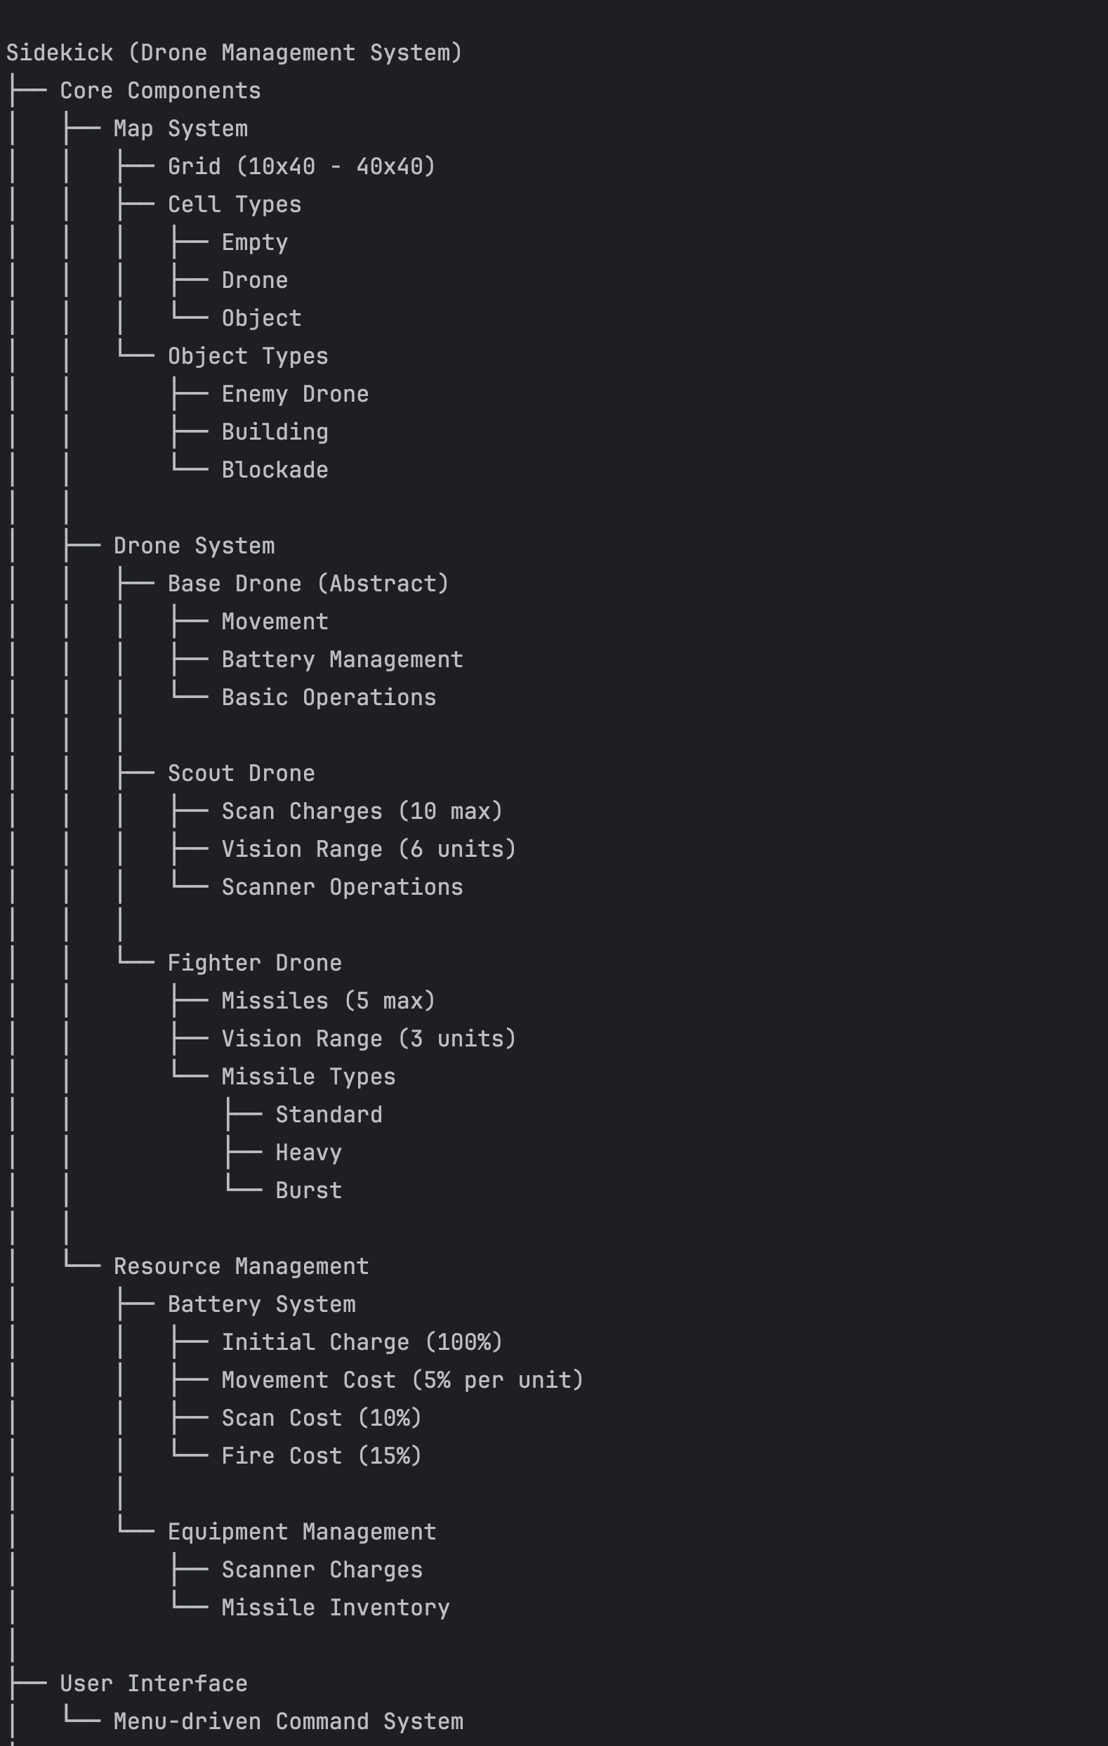
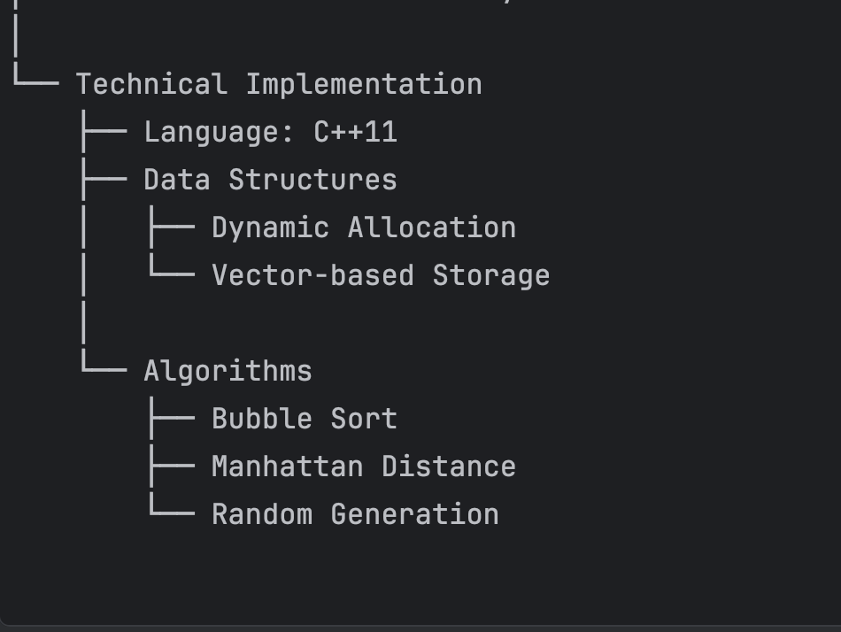

Slide 4
Sidekick DEMO!

Slide 5
Future Work and Conclusion
Real world implementation with ROS or Arduino
Learn more of the physical engineering side of Programming

